Slide 1

Notes:
For my project I selected a dataset from data.gov.
I chose to use BCBS because the majority of people can recognize BCBS of Texas.
So, …

Slide 2

Complaints and Business Growth Analysis 2019 - 2023
By Ricky Reyes
Notes:
Let’s take a moment to look back — and more importantly, to look ahead — as we review our Complaints and Business Growth Analysis from 2019 to 2023.
So the question …

Slide 3

How can Blue Cross and Blue Sheild(BCBS) use complaint data to improve customer retention and regulatory compliance?
Notes:
we ask ourselves is,
As we take a look …

Slide 4
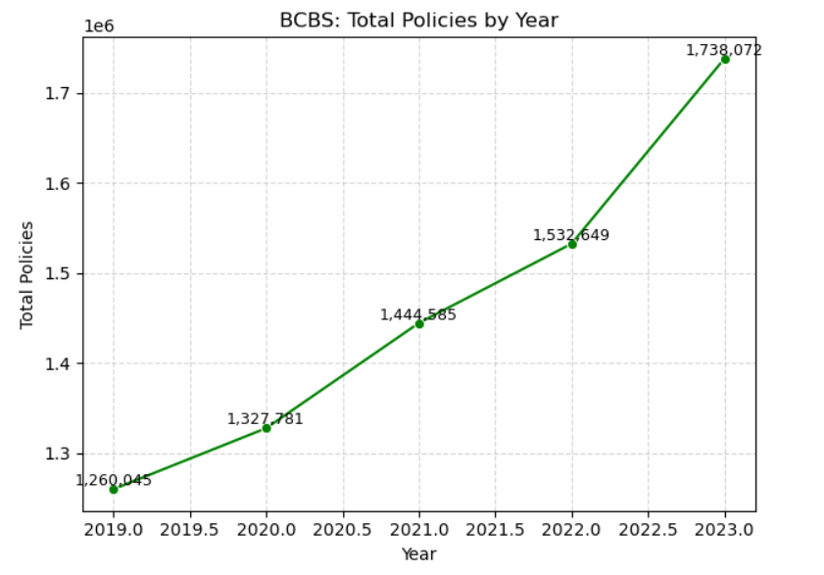
Business growth over four years.
Notes:
At our business growth over the past 4 years, we can see a clear and encouraging trend.
Our active policies have steadily increased within the Accident and Health category, as defined by the TDI. For us, these active policies are exclusively within the Health Insurance.
In 2019, we began with 1,260,045 active policies. From there, we’ve seen consistent, year-over-year growth, reflecting both the expanding demand for health coverage and our commitment to meeting that need.
By 2023, our number of active policies reached 1,738,072.

Slide 5
CONFIRMED COMPLAINT
For Texas Department of Insurance(TDI), a confirmed complaint is a grievance that TDI has reviewed and determined to be valid.
A complaint can be confirmed two ways:
Notes:
Let’s take a moment to define what a Confirmed Complaint means according to the TDI.
A confirmed complaint is a grievance that TDI has reviewed and determined to be valid. In other words, after investigating a consumer’s complaint, TDI found that the company did not follow a law, rule, or policy provision, or failed to handle the situation properly.
A complaint can be confirmed in two ways:

Slide 6

1. Violation of rules: TDI determines that an insurer has violated: a. A Texas Texas law or regulation b. A federal requirement TDI can enforce c. A specific term or condition of a policy or certificate 2. Valid reason for complaint: TDI finds that the insurer’s actions or response were in error, or that the customer had a legitimate reason to complain.
Notes:
TDI finds a violation — meaning the company did not comply with a specific regulation or policy requirement.
The company takes corrective action — for example, making a payment, reversing a denial, or fixing an error after the complaint was filed.

Slide 7
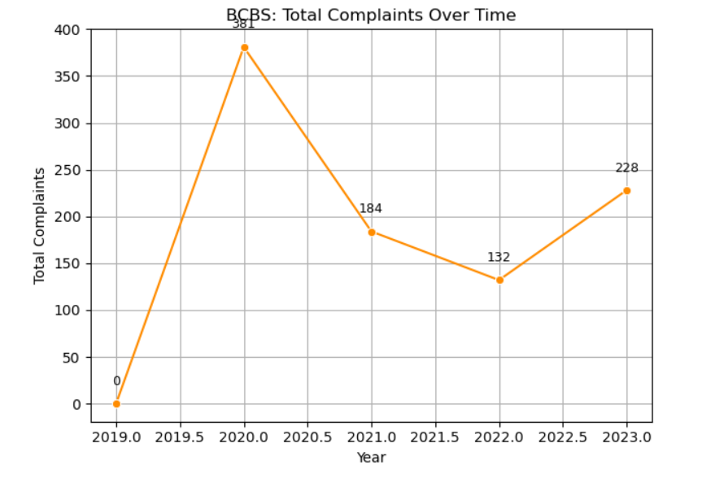
Complaints that the Texas Department of Insurance has identified as valid.
Notes:
Now, let’s take a look at our complaints data — specifically, the complaints that the Texas Department of Insurance (TDI) has identified as valid, or what they refer to as Confirmed Complaints.
As our number of active policies has grown, it’s natural that we’ve also seen an increase in overall complaint activity.
These confirmed complaints represent cases where TDI found that we did not meet certain policy provisions, contractual obligations, or regulatory requirements.
In 2020, our confirmed complaints were at their highest — 381 cases. It’s possible that this spike was influenced by the COVID-19 pandemic, which created unique challenges in claims processing, customer communication, and policy coverage.
Following that year, we saw a significant improvement:
In 2021, confirmed complaints dropped to 184,
And again in 2022, they decreased further to 132.
However, in 2023, we saw an uptick to 228 confirmed complaints.

Slide 8
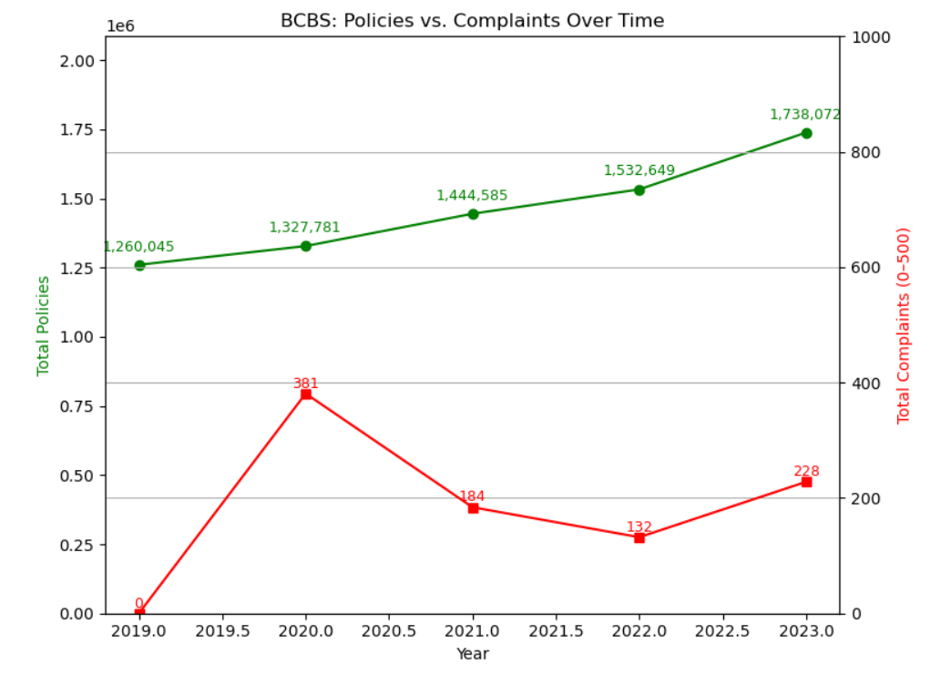
Active Policies versus Complaints over time.
Notes:
Here, we can see the relationship between our active policies and the number of complaints received over time.
As our active policies increased steadily year after year, our complaints peaked in 2020.
Following 2020, we saw a notable drop in complaints — first in 2021, and again in 2022 — showing real improvement in how we handled customer issues and maintained compliance.
However, in 2023, there was a slight increase in complaints, even as sales continued to rise.

Slide 9
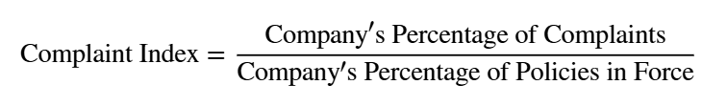
Texas Department of Insurance (TDI) ‘Complaint Index’ is calculated by dividing the company's percentage of complaints for a specific line of insurance by the company's percentage of policies in force for the same line of insurance.
Notes:
Let’s take a moment to look at how the TDI, defines the Complaint Index.
Simple terms for this formula, it shows whether a company receives more, fewer, or about the same number of complaints as others in the same market.

Slide 10
Interpreting the TDI complaint index.
An index less than 1.00 indicates the company received fewer complaints than average. The lower the index, the better the performance.
An index of 1.00 means the company received a proportionate number of confirmed complaints for its market share.
An index greater than 1.00 means the company received more complaints than average.
Notes:
An index value less than 1.0 means fewer complaints than expected.
A value of 1.0 means the company’s complaint level is average for its size.
A value above 1.0 indicates more complaints than expected,
This metric helps TDI gauge how well a company serves its policyholders compared to its peers.

Slide 11
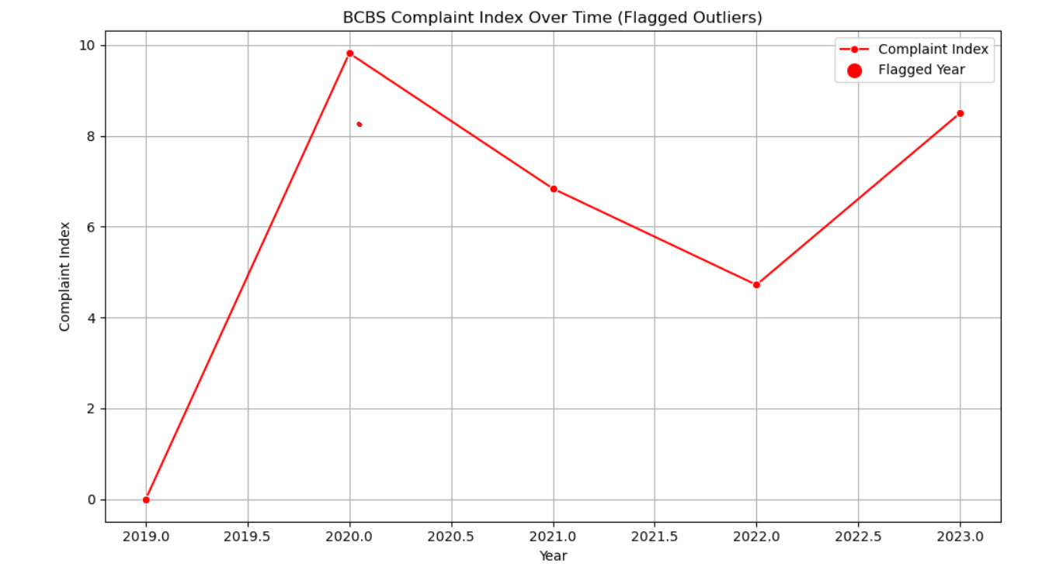
Complaint Index over time.
Notes:
Now, let’s look at our Complaint Index over time, as defined by the TDI.
In 2020, our complaint index was 9.82, a relatively high figure that reflected the challenges many companies faced during the early stages of the COVID-19 pandemic.
We then saw a steady improvement:
In 2021, the index dropped to 6.84,
In 2022, it further decreased to 5.15,
And in 2023, we see an increase to 8.42.

Slide 12
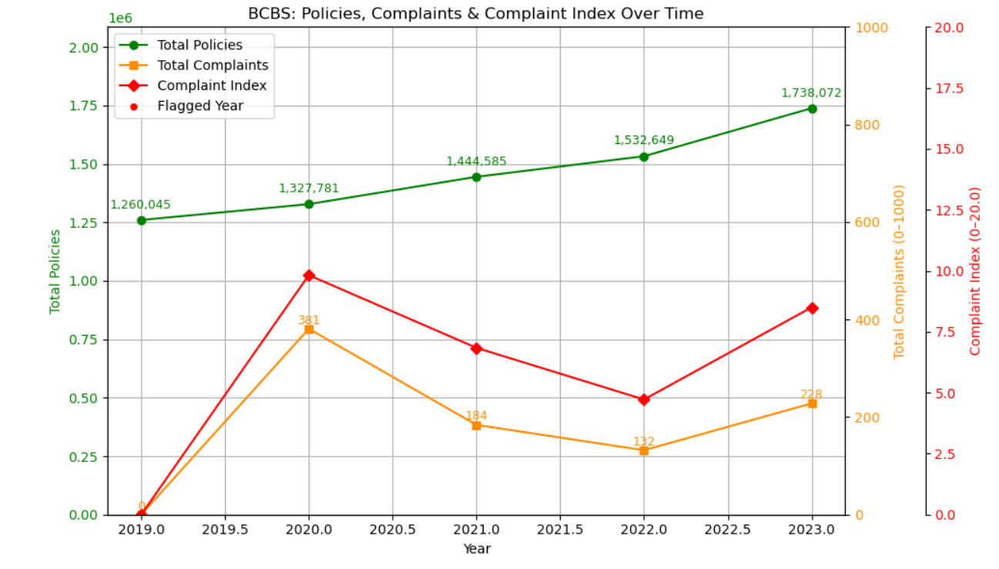
Growth, Complaints and Index Comparison
Notes:
Over the past five years, our Health Insurance policies have grown steadily, from 1,260,045 active policies in 2019 to 1,738,072 in 2023.
With growth, confirmed complaints naturally fluctuated: peaking at 381 in 2020, dropping 132 in 2022, before rising slightly to 228 in 2023.
Our Complaint Index shows steady improvement over the same period: 9.82 in 2020, down to 5.15 in 2022, and an increase to 8.42 in 2023.

Slide 13

Steps Towards Excellence
Enhancing Customer Service
Strengthening Complaint Handling
Improve Compliance
Using Data for Drive Improvement
Notes:
To reduce complaints and improve our Complaint Index, we will focus on four key areas:
Enhancing Customer Service – clear, timely communication and staff training.
Strengthening Complaint Handling – faster resolution and identifying recurring issues.
Improving Compliance – ensuring all policies and claims meet TDI regulations.
Using Data to Drive Improvement – monitoring trends and targeting high-risk areas.

Slide 14

Thank you

